Slide 1

Effectiveness of Remote Work on Employee Productivity

Slide 2

Introduction
1
Definition
2
Relevance
Remote work is performing job duties outside a traditional office, encompassing various locations and evolving with technology. It's increasingly integral to modern work.
The COVID-19 pandemic accelerated remote work adoption, while advancements in technology (high-speed internet, cloud computing, video conferencing, and collaborative software) enabled its effectiveness.
3
Key Focus
This presentation analyzes remote work's impact on employee productivity, job satisfaction, work-life balance, and organizational performance, aiming for a comprehensive understanding of its benefits and challenges.

Slide 3
Research Gap
Long-Term Impact
Industry-Specific Needs
Longitudinal studies are needed to assess remote work's long-term effects on employee well-being, productivity, and career progression, considering individual differences and job types.
Research should address industry-specific remote work challenges to develop tailored solutions and policies.
DE&I in Remote Work
Emerging Technologies
Research should address potential DE&I biases in remote work and develop mitigating strategies.
Research is needed on AI and VR's impact on remote work, considering productivity, ethics, and social isolation.
Mental Health
Data Security and Privacy
Research should focus on effective strategies to support employee mental health in remote work, addressing both benefits and drawbacks.
Research should address balancing robust data security with employee privacy in remote work environments.

Slide 4




Research Objectives
Productivity & Retention
Industry Challenges
Mental Well-being
Technology Infrastructure
Explore sector-specific remote work challenges via case studies, highlighting best practices and pitfalls.
Investigate interventions (mental health resources, EAPs, training) to improve remote worker well-being.
Analyze long-term productivity and retention, considering engagement, work-life balance, and remote management.
Examine technology infrastructure's impact on remote work effectiveness and employee experience.

Slide 5





Research Questions
Long-Term Impacts
What are the long-term effects of remote/hybrid work on productivity, burnout, and career trajectories, considering flexible work?
Industry-Specific Factors
How do industry-specific factors (regulations, tech, job needs, culture) affect remote work implementation and success?
Mental Health Challenges
What strategies best mitigate remote work's mental health challenges, including support systems and management practices?
Equity and Inclusion
How do remote work policies affect equity and inclusion, and how can we mitigate potential biases?
AI and VR Integration
How can AI and VR enhance remote collaboration and productivity, considering both benefits and challenges?

Slide 6

Literature Review
Tangible factor
Intangible factor
Technology
Employee well-being
IT Infrastructure
Organizational culture
Office space cost savings
Leadership style
Employee work environment.
Employee engagement

Slide 7
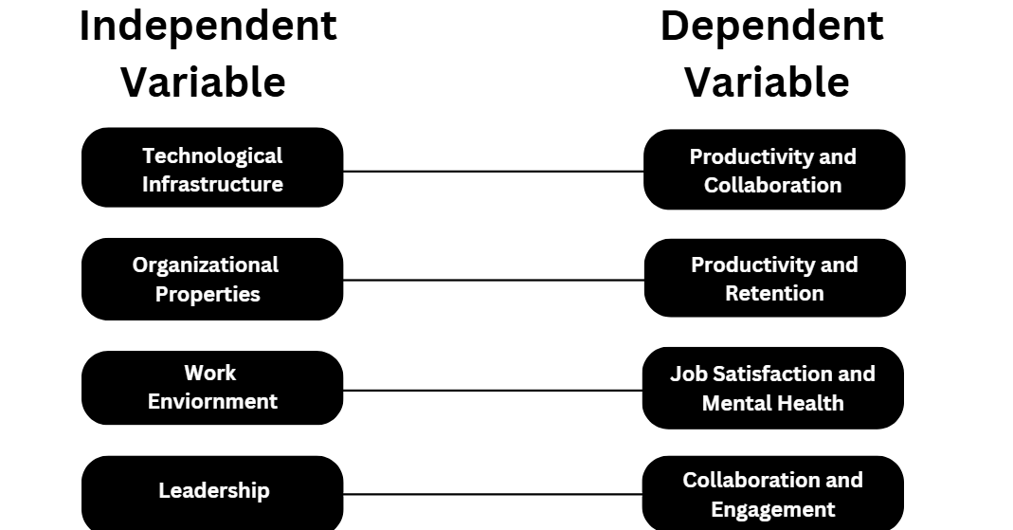

Slide 8
Methodology
Approach
Data Sources
Techniques
This research used a mixed-methods approach, combining qualitative and quantitative data analysis for a comprehensive understanding. Qualitative data provided in-depth exploration, while quantitative data allowed for broader statistical analysis.
Data came from surveys of remote workers (quantitative), semi-structured interviews with workers, managers, and HR (qualitative), and secondary data (industry reports, prior research).
Data analysis involved statistical methods (descriptive statistics, correlation, regression) for the survey data and thematic analysis for the interview data. Both approaches converged to strengthen our findings.

Slide 9
Key Findings
Positive Impacts
Challenges
Increased productivity on individual tasks.
Isolation and reduced team cohesion.
Improved work-life balance and reduced stress.
Difficulty managing accountability and communication.
Lower costs and wider talent access for companies.
Technology and infrastructure limitations.
Greater autonomy and job satisfaction.
Blurred work-life boundaries.

Slide 10
Recommendations
For Organizations
For Employees
Invest in robust collaboration tools.
Communicate needs and concerns.
Prioritize inclusivity and well-being.
Maintain accountability and proactive communication.
Establish clear remote work policies.
Manage time effectively and set boundaries.
Provide remote work training.
Engage actively in team communication.
Ensure reliable IT support.
Develop self-discipline and motivation.
Promote team interaction.
Utilize available resources.

Slide 11

Hypothesis
H1:
Remote and hybrid work models have a positive
long-term impact on employee productivity and
job satisfaction.
H2:
strategies to support mental health and well-being
reduce stress and improve employee retention.

Slide 12


Conclusion
Summary
Takeaway
Thoughtfully implemented remote work boosts productivity and employee satisfaction. Success relies on clear communication, flexible arrangements, and prioritizing well-being.
Hybrid models offer a path to sustainable success. By carefully integrating remote and in-office work, companies can optimize productivity, morale, and inclusivity.

Slide 13
